Slide 1

Recurrent Neural Networks
汤斯亮（Siliang Tang）
siliang@zju.edu.cn

Slide 2
Variants of Neural Networks
Convolutional Neural Network (CNN)
Recurrent Neural Network (RNN)
Neural Network with Memory

Slide 3
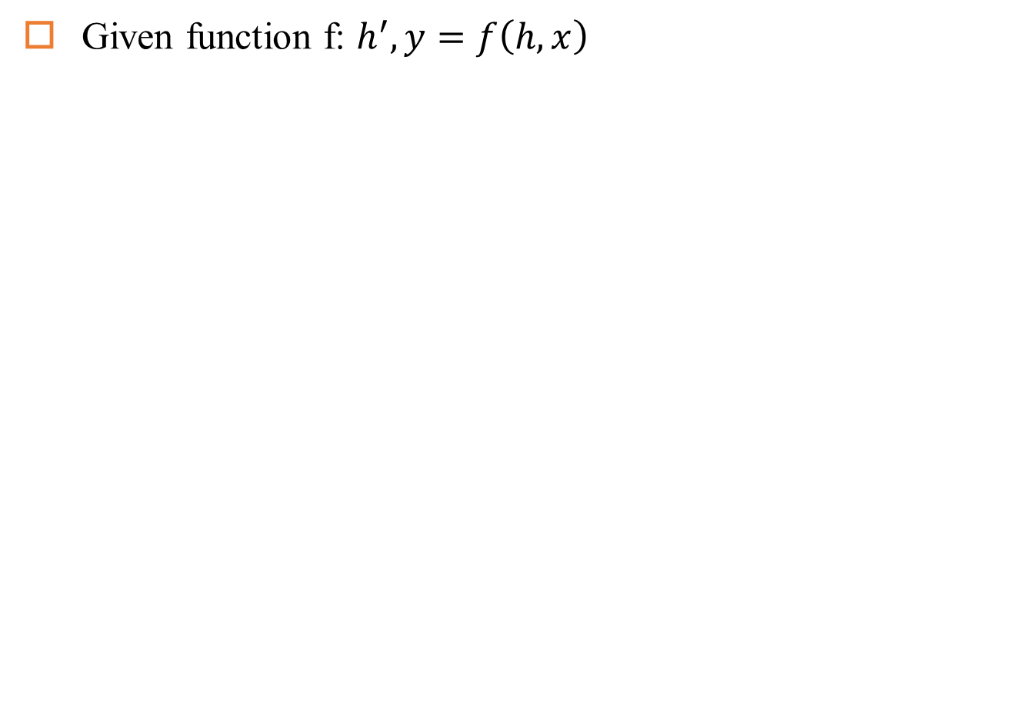
Recurrent Neural Network
Given function f: $h^{′},y=f\left(h,x\right)$
h and h’ are vectors with the same dimension
y¹
y²
y³
h⁰
f
h¹
f
h²
f
h³
……
x¹
x²
x³
No matter how long the input/output sequence is, we only need one function f

Slide 4
Recurrent Neural Network
Given function f: $h^{′},y=f\left(h,x\right)$
h and h’ are vectors with the same dimension
y¹
y²
y³
h⁰
f
h¹
f
h²
f
h³
……
x¹
x²
x³
No matter how long the input/output sequence is, we only need one function f

Slide 5
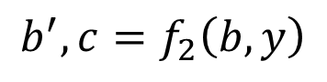
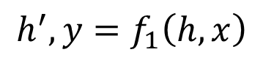
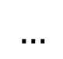
Deep RNN
$$h^{′},y=f_{1}\left(h,x\right)$$
$$b^{′},c=f_{2}\left(b,y\right)$$
$$…$$
…
…
…
c¹
c²
c³
b⁰
f₂
b¹
f₂
b²
f₂
b³
……
y¹
y²
y³
h⁰
f₁
h¹
f₁
h²
f₁
h³
……
x¹
x²
x³

Slide 6
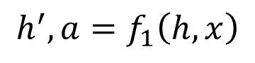
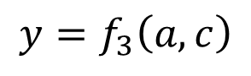
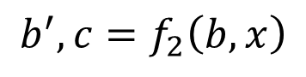
Bidirectional RNN
$$h^{′},a=f_{1}\left(h,x\right)$$
$$b^{′},c=f_{2}\left(b,x\right)$$
x¹
x²
x³
b⁰
f₂
b¹
f₂
b²
f₂
b³
c¹
c²
c³
y¹
y²
y³
$$y=f_{3}\left(a,c\right)$$
f₃
f₃
f₃
a¹
a²
a³
h⁰
f₁
h¹
f₁
h²
f₁
h³
x¹
x²
x³

Slide 7
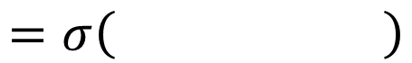
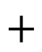
Naïve RNN
Given function f: $h^{′},y=f\left(h,x\right)$
y
h'
W^{h}
h
W^{i}
x
$$+$$
$$=σ\left( \right)$$
h
f
h'
y
Wº
h'
$$=σ\left( \right)$$
x
softmax
Ignore bias here

Slide 8
LSTM
y^{t}
LSTM
c^{t}
y^{t}
c^{t-1}
Naive
h^{t}
h^{t}
h^{t-1}
h^{t-1}
x^{t}
x^{t}
c changes slowly
c^{t} is c^{t-1} added by something
h changes faster
h^{t} and h^{t-1} can be very different

Slide 9
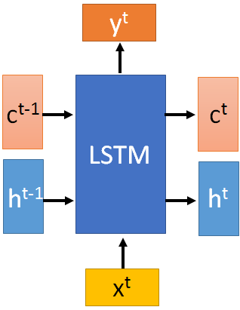
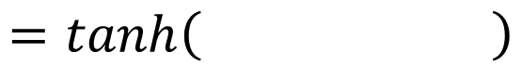
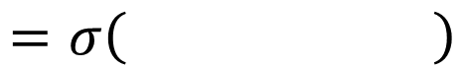
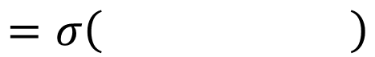
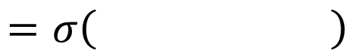
x^{t}
z
W
$$=tanh\left( \right)$$
h^{t-1}
c^{t-1}
x^{t}
z^{i}
W^{i}
$$=σ\left( \right)$$
h^{t-1}
Input
gate
x^{t}
z^{f}
W^{f}
$$=σ\left( \right)$$
h^{t-1}
z^{f}
z^{i}
z
zº
forget
gate
x^{t}
zº
Wº
$$=σ\left( \right)$$
h^{t-1}
x^{t}
h^{t-1}
output
gate

Slide 10
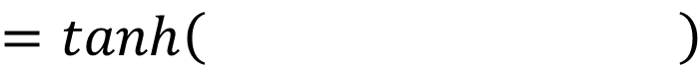
x^{t}
z
W
h^{t-1}
$$=tanh\left( \right)$$
c^{t-1}
c^{t-1}
diagonal
“peephole”
zº
z^{f}
z^{i}
obtained by the same way
z^{f}
z^{i}
z
zº
h^{t-1}
x^{t}

Slide 11

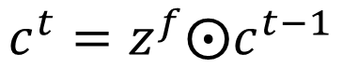

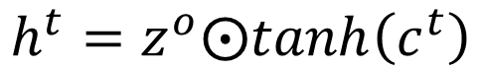
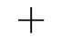
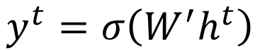
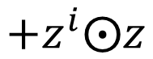

y^{t}
c^{t-1}
c^{t}
$$⨀$$
$$＋$$
$$⨀$$
$$c^{t}=z^{f}⨀c^{t−1}$$
$$+z^{i}⨀z$$
$$⨀$$
$$h^{t}=z^{o}⨀tanh\left(c^{t}\right)$$
z^{f}
z^{i}
z
zº
$$y^{t}=σ\left(W^{′}h^{t}\right)$$
h^{t-1}
x^{t}
h^{t}

Slide 12




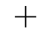

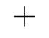

LSTM
y^{t}
y^{t+1}
c^{t-1}
c^{t}
c^{t+1}
$$⨀$$
$$＋$$
$$⨀$$
$$⨀$$
$$＋$$
$$⨀$$
$$⨀$$
$$⨀$$
z^{f}
z^{i}
z
zº
z^{f}
z^{i}
z
zº
h^{t+1}
h^{t-1}
x^{t}
h^{t}
x^{t+1}

Slide 13
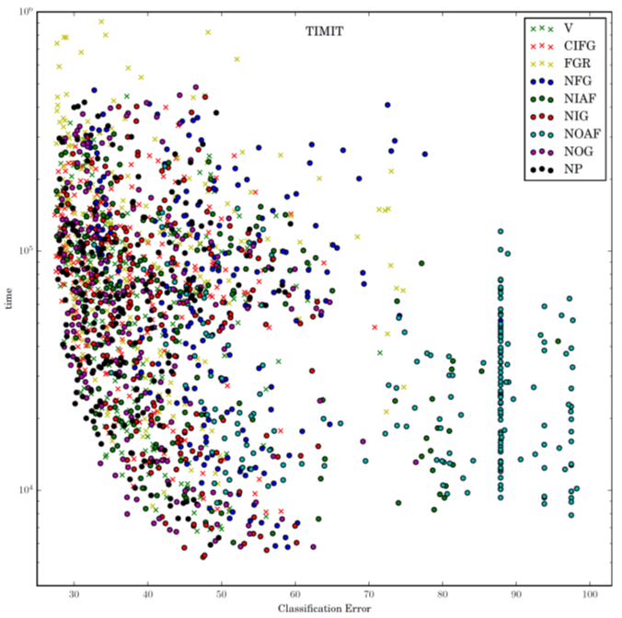
LSTM: A Search Space Odyssey

Slide 14
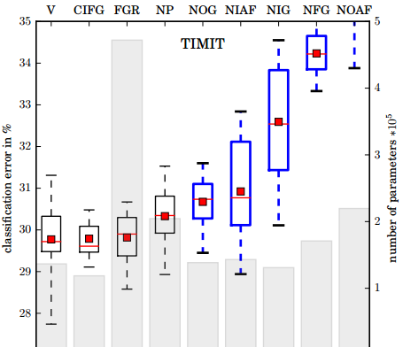
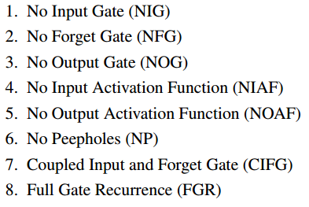
LSTM: A Search Space Odyssey
Standard LSTM works well
Simply LSTM: coupling input and forget gate, removing peephole
Forget gate is critical for performance
Output gate activation function is critical

Slide 15
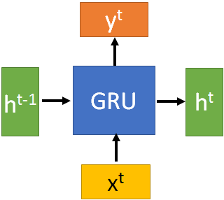
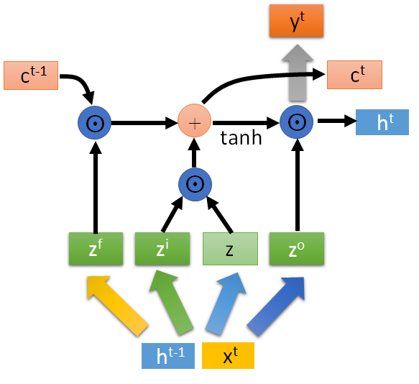
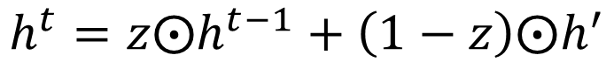
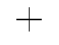



GRU
$$h^{t}=z⨀h^{t−1}+\left(1−z\right)⨀h^{′}$$
y^{t}
h^{t-1}
$$⨀$$
$$＋$$
h^{t}
$$⨀$$
1-
$$⨀$$
reset
update
r
z
h'
h^{t-1}
x^{t}
x^{t}

Slide 16
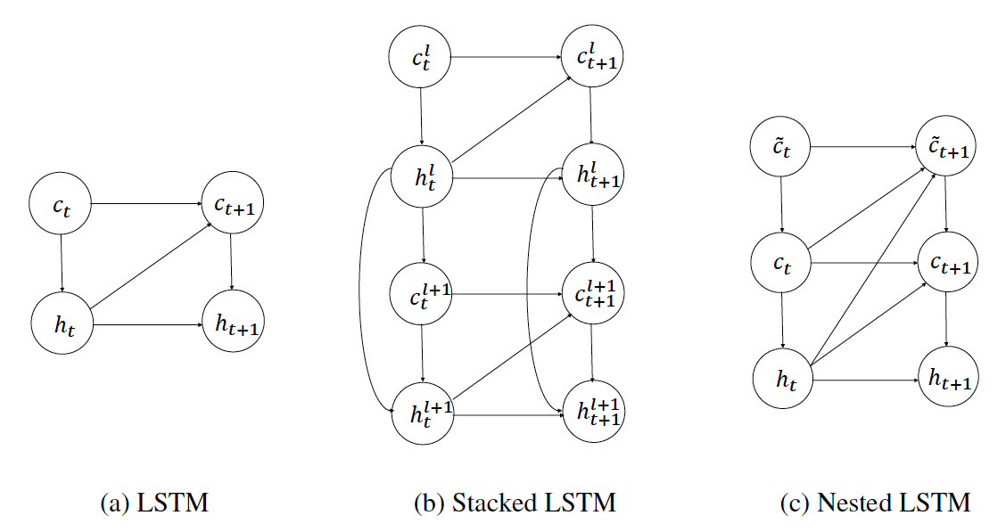
Nested LSTM
Moniz J R A, Krueger D. Nested lstms[J]. arXiv preprint arXiv:1801.10308, 2018.

Slide 17
RNN for NLP

Slide 18
Long-distance Dependencies
NLP is full of sequential data
Words in sentences
Characters in words
Sentences in discourse
…
RNNs is good at capturing long-distance dependencies. E.g.,
1. Agreement in number, gender, etc.
He does not have very much confidence in himself.
She does not have very much confidence in herself.
2. Selectional preference
The reign has lasted as long as the life of the queen.
The rain has lasted as long as the life of the clouds.
3. What is the referent of “it”?
The trophy would not fit in the brown suitcase because it was too big.
The trophy would not fit in the brown suitcase because it was too small.
From Winograd Schema Challenge: http://commonsensereasoning.org/winograd.html

Slide 19
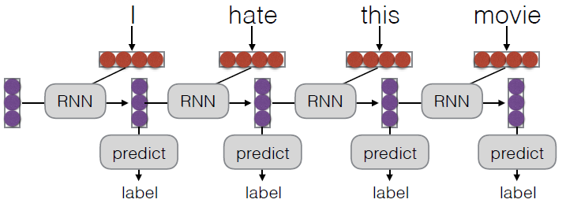
Unrolling in Time
What does processing a sequence look like?

Slide 20
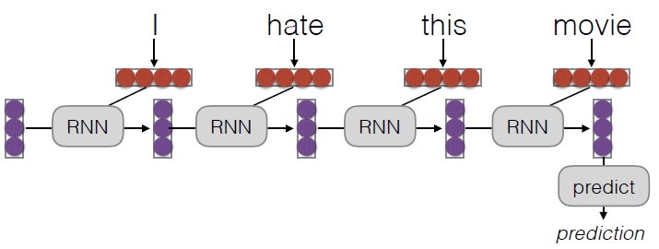
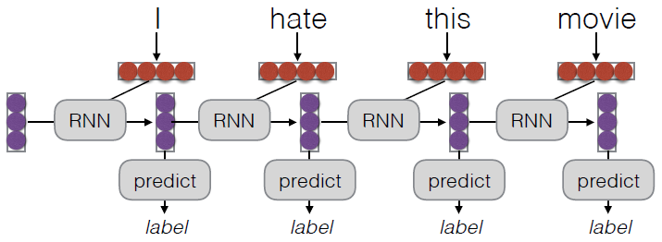
What Can RNNs Do?
Represent a sentence
Read whole sentence, make a prediction
Sentence classification, Conditioned generation, Retrieval
Represent a context within a sentence
Read context up until that point
Tagging, Language Modeling, Calculating Representations for Parsing, etc.

Slide 21
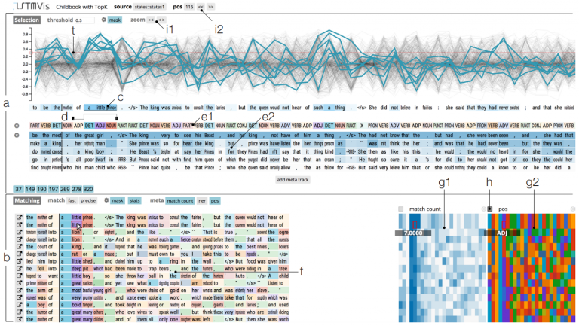
What can LSTMs Learn?
http://lstm.seas.harvard.edu/

Slide 22
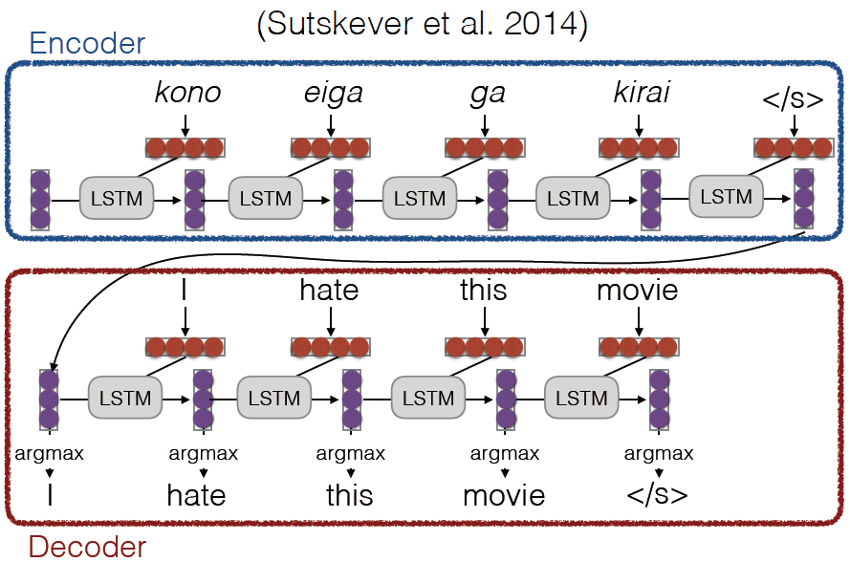
Encoder-decoder Models

Slide 23
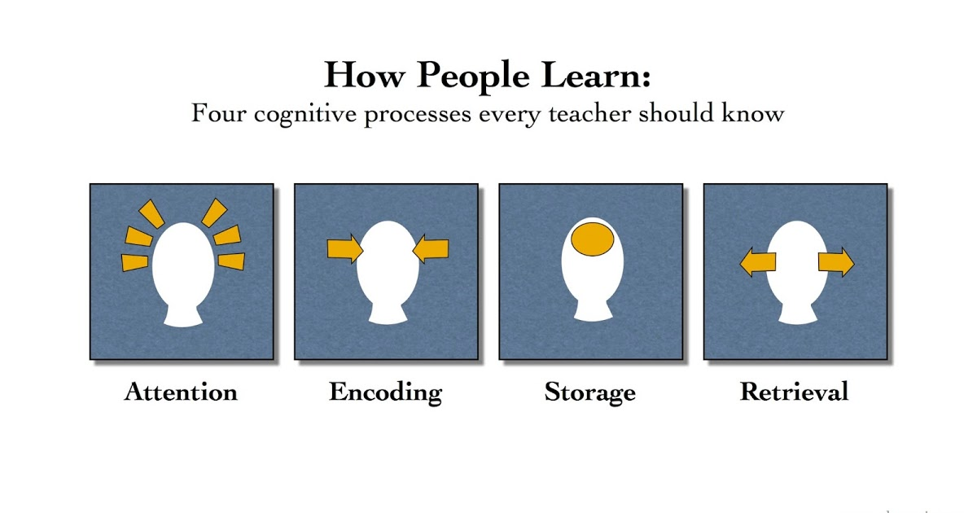
Attention

Slide 24
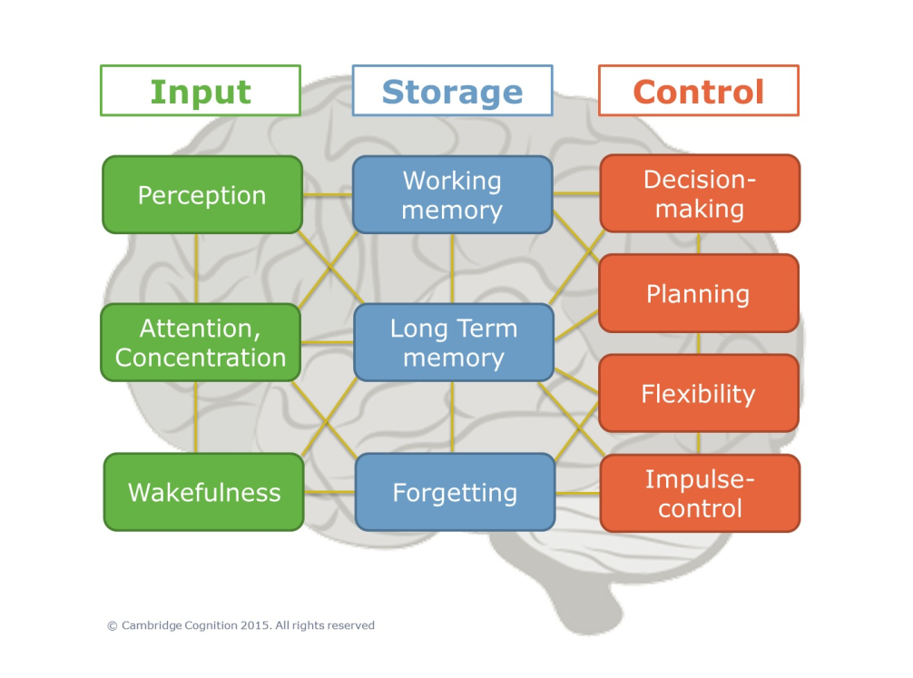



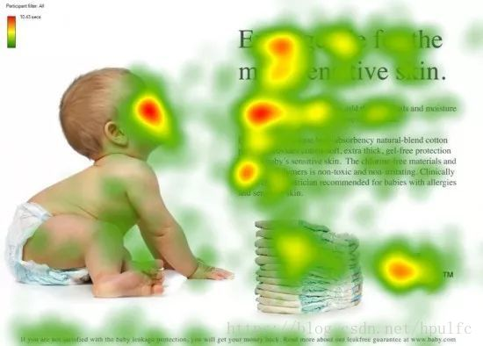
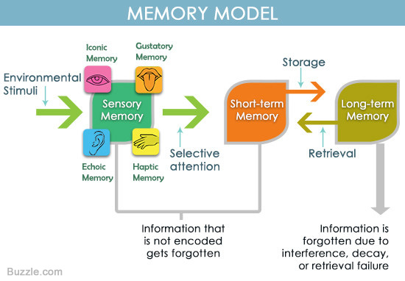
Attention

Slide 25
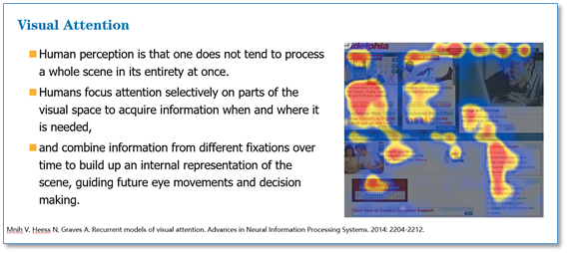
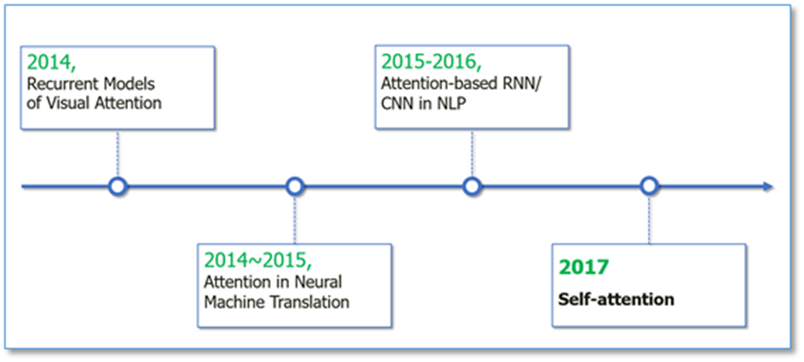
Attention

Slide 26
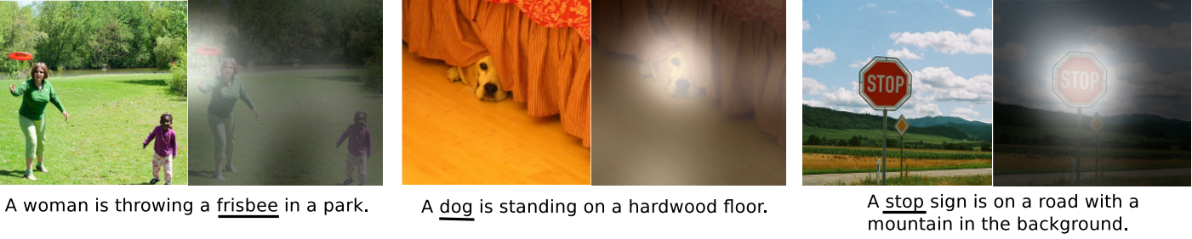
Attention
Encode each word in the sentence into a vector
When decoding, perform a linear combination of these vectors, weighted by “attention weights”
Use this combination in picking the next word

Slide 27
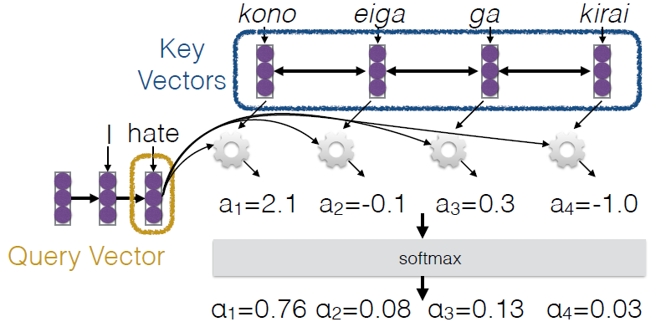
Calculating Attention (1)
Use “query” vector (decoder state) and “key” vectors (all encoder states)
For each query-key pair, calculate weight
Normalize to add to one using softmax
-1.0
2.1
0.03
0.76

Slide 28
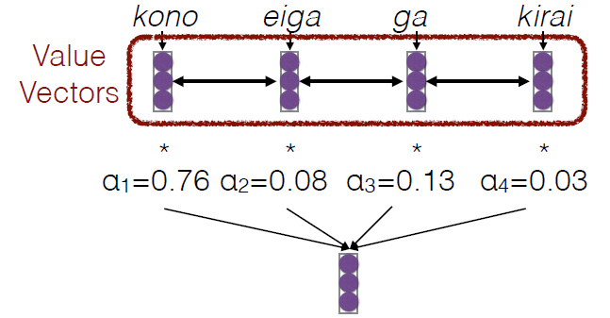
Calculating Attention (2)
Combine together value vectors (usually encoder states, like key vectors) by taking the weighted sum
Use this in any part of the model you like
0.03
0.76

Slide 29
A Graphical Example

Slide 30
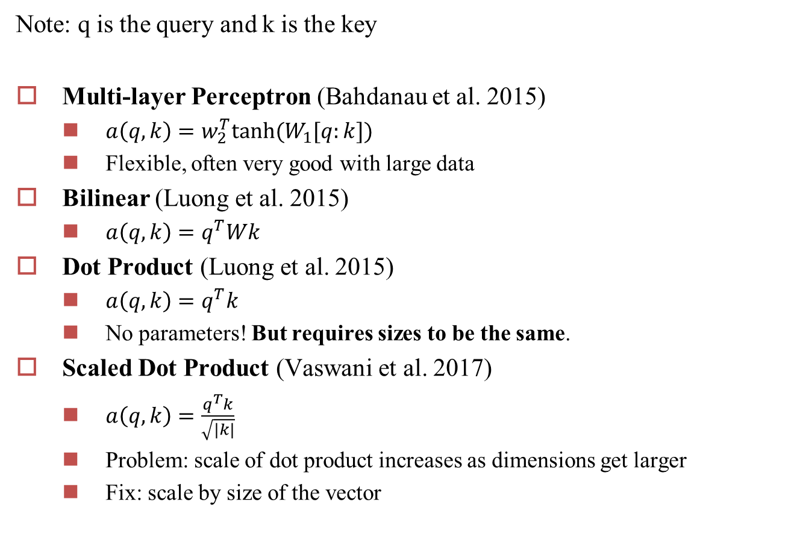
Attention Score Functions
Note: q is the query and k is the key
Multi-layer Perceptron (Bahdanau et al. 2015)
$a\left(q,k\right)=w_{2}^{T}tanh⁡(W_{1}[q:k])$
Flexible, often very good with large data
Bilinear (Luong et al. 2015)
$a\left(q,k\right)=q^{T}Wk$
Dot Product (Luong et al. 2015)
$a\left(q,k\right)=q^{T}k$
No parameters! But requires sizes to be the same.
Scaled Dot Product (Vaswani et al. 2017)
$a\left(q,k\right)=\frac{q^{T}k}{\sqrt{|k|}}$
Problem: scale of dot product increases as dimensions get larger
Fix: scale by size of the vector

Slide 31
Attention Variants
Copying mechanism [Gu et al. 2016]
Attend to the previous words (input, output) [Merity et al. 2016]
Attend to multi-modal inputs (image, speech) [Xu et al. 2015; Chan et al. 2015;…]
Attend to multiple sources [Zoph et al. 2015;…]
…

Slide 32
Hierarchical Structures
Encode with attention over each sentence, then attention over each sentence in the document
[Yang et al. 2016]

Slide 33
Hard Attention
Instead of a soft interpolation, make a zero-one decision about where to attend (Xu et al. 2015)
Harder to train, requires methods such as reinforcement learning
Perhaps this helps interpretability? (Lei et al. 2016)

Slide 34
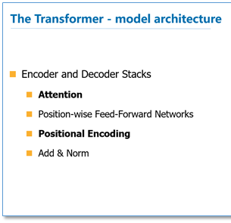
Attention is All You Need
Transformer
A sequence-to-sequence model
based entirely on attention
Strong results on standard
WMT datasets
Fast: only matrix multiplications

Slide 35
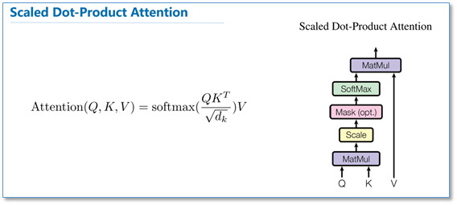
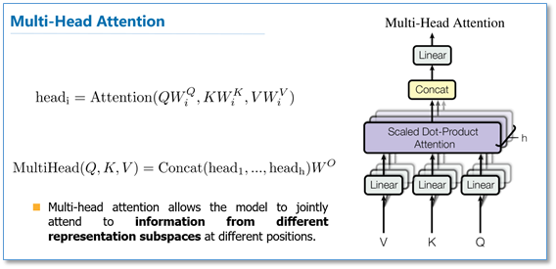
Multi-headed Attention

Slide 36
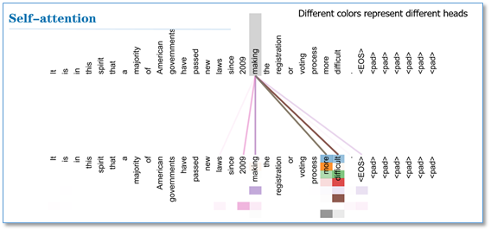
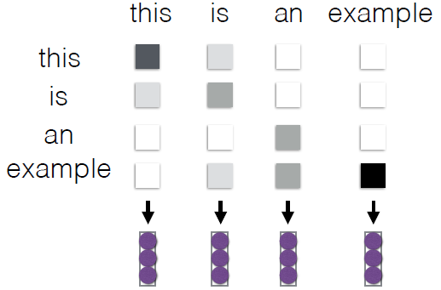
Intra-Attention / Self Attention
Each element in the sentence attends to other elements → context sensitive encodings!

Slide 37

Attention is All You Need

Slide 38


Language Models other than Word2Vec
the ImageNet moment of NLP

Slide 39


Pointer Network
Looking for a convex hull (Find a few points to wrap all the points)
A simple idea: use Seq2Seq model
Input: $\left(x_{i},y_{i}\right)$ Output: the convex hull
Problem: The output size of decoder is fixed. We need to find a way to dynamically output results. The output size should depend on the input.

Slide 40


Pointer Network
The solution of the convex hull is the process of selecting points from the input sequence $\{P_{i}\}$.

Slide 41



Pointer Network

Slide 42

Pointer Network Applications
Summarization
Machine Translation

Slide 43

Attention and Augmented RNN
https://distill.pub/2016/augmented-rnns/

Slide 44

NTM: Neural Turing Machines
RNN 是 Turing-complete 的，可以用来模拟任何函数，当然也可以模拟任何程序的功能。
NTM extends the capabilities of neural networks by coupling neural networks to external memory resources.
In particular, every component in the architecture is differentiated, which makes gradient descent training more straightforward.

Slide 45


NTM: Neural Turing Machines
NTMs 如何寻址?
Content-based attention + Location-based attention
Content-based attention: allows NTMs to search through their memory and focus on places that match what they’re looking for
Location-based attention: allows relative movement in memory, enabling the NTM to loop.
Content-based attention
Location-based attention

Slide 46


DNC: Differentiable Neural Computer
Von Neumann architecture

Slide 47
DNC: Differentiable Neural Computer
DNC 改进了 NTM 的寻址机制
NTM 不能保障多个存储单元之间，不相互重叠，不相互干扰
dynamic memory allocation: allocate a free space
NTM 不能释放存储单元，如果处理很长的序列时，譬如处理一部超长的长篇小说，搞不好所有存储都会被占满，导致系统崩溃
dynamic memory allocation: free gates
NTM 中，一旦某个读写操作，远跳到其它存储区域，那么后续操作也跟着去其它区域。NTM由于没有时序链接会想不起来原先的存储区域在哪里
temporal link matrix

Slide 48

ACT: Adaptive Computation Time
RNN每次的计算量是固定的（一次执行一个Cell）。自适应计算(ACT) 允许RNN在每次执行多轮（一次执行一个Cell多次 ），可以理解为在RNN中嵌入RNN。
采用之前Attention相同的技巧，并不去决定轮数这个离散量，而是在轮数上分配注意力，最后的输出是多轮结果的加权和。
在训练ACT模型时，通常会引入“思考成本” (ponder cost)作为损失函数的一部分，对过多计算进行惩罚。

Slide 49


Neural Programmer
The program is generated one operation at a time by a controller RNN.
将神经网络和常规编程结合
如：生成SQL代码查询
基本想法是运行所有的操作，然后用Attention来分配结果的权重

Slide 50
Any Questions?

